Slide 1
Mourya praharsha Bobbili(16251221)
Part-3

Slide 2
columnar memory store
naive
shark
It collects the data from cache disks.
On-demand serialization in query processor.
Deserialization is bottle neck.
Shark implies combination of naïve and column memory store.
It stores all data partitions as JVM objects.
Query processor use those JVM objects directly.
It avoid the Deserialization.

Slide 3
Limitations in Shark
Storage overheads(12 to 16bytes of overhead per object)
Garbage Collection is time consuming.
Large variability in response times.

Slide 4
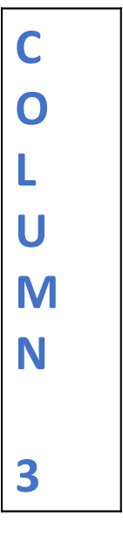
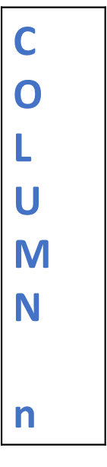


Distributed Data Loading
Max degree Parallelism
T | Row 1
A | Row 2
B | Row 3
L
E | Row n
C O L U M N 1
C O L U M N n
Spark Task 1
Spark Task 3
Column Compression Threshold
Notes:
Table->Split
Uses Data Schema to extract individual fields from rows and store those columns in memory
Threshold decides the column to be compressed or not
Each data loading task tracks metadata to decide whether each column in a partition should be compressed
This allows each task to choose the best compression scheme for each partition
Local partition scheme over global partition scheme
Which do not need coordination – Max degree of parallelism
Remember:
RDD do not contain compression scheme and metadata as they are by-products of RDD computation

Slide 5
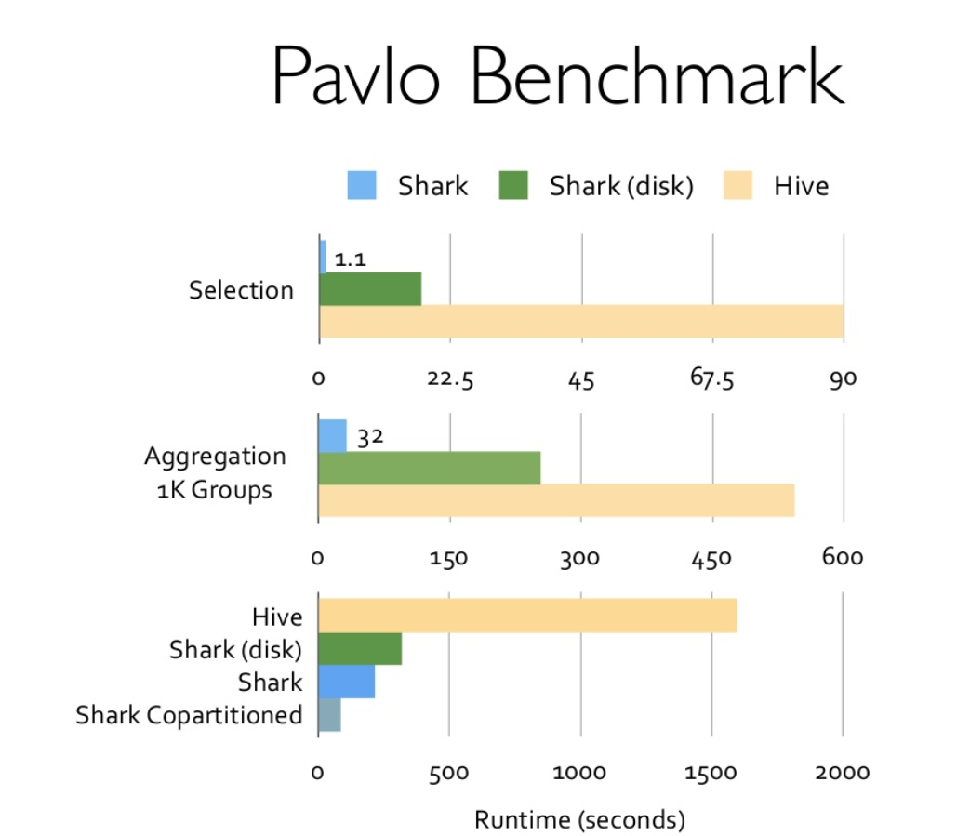
https://www.slideshare.net/Hadoop_Summit/xin-june27-425pmroom230c
Notes:
2.1 TB of data reproducing Pavlo et
al.’s comparison of MapReduce vs. analytical DBMSs
Meaning Shark can load data into memory at best CPUs processing incoming data
Comparison
Hadoop performed data loading 5 to 10 times MPP DBs
Shark provides same throughput as Hadoop
In memory store, 5 times faster

Slide 6
Co-Partitioning – A Powerful Feature
2 tables are frequently joined together in warehouse workloads
TPC-H – Decision Support Benchmark supports the same
MPP employs co-partition during data loading
However, most DFS like HDFS being schema-agnostic prevents this.
But Shark joins 2 tables using this feature on a common key for faster joins with DISTRIBUTE BY clause
http://www.tpc.org/tpch/
Notes:
TPC- H
Transaction Performance Processing Council
Consists of a suite of business oriented ad-hoc queries and concurrent data modifications.

Slide 7
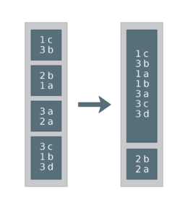
Co-Partition?? → Partitioned the same way
Simple explanation of how “DISTRIBUTE BY” works
Example of a (Key, Value) pair Table
Query:
→SET spark.sql.shuffle.partitions = 2
→SELECT * FROM df DISTRIBUTE BY key
→df.repartition($"key", 2)
https://blog.deepsense.ai/optimize-spark-with-distribute-by-and-cluster-by/

Slide 8
Co-Partitioning with Tables
CREATE TABLE l_mem TBLPROPERTIES ("shark.cache"=true) AS SELECT * FROM lineitem DISTRIBUTE BY L_ORDERKEY;
CREATE TABLE o_mem TBLPROPERTIES ("shark.cache"=true, "copartition"="l_mem") AS SELECT * FROM order DISTRIBUTE BY O_ORDERKEY;
→Shark’s optimizer constructs a DAG that avoids the expensive shuffle and instead uses map tasks to perform the join

Slide 9
Partition Statistics
Data is stored using some logical clustering on one or more columns
For analytical queries, it is typical to apply filter predicates or aggregations over such columns
For example, a daily warehouse report might describe how different visitor segments interact with the website
Means a predicate is applied on timestamps and aggregations are performed that are grouped by geographical location

Slide 10

Map Pruning
Data Partitions
In-query filter range
Out-query filter range
Resultant Data blocks
“You NeedMe” Block
“Not Me” Block
“You Need Me” Block
After Data Scanning
Avoids scanning certain unwanted blocks of data falling out of query’s filter range
Notes:
Pruning?? –Trimming actually
Process of pruning data partitions based on natural clustering columns
Data -> Small partitions
Means 1 block contains only one or few columns

Slide 11

Piggybacking
Piggybacker
Statistics
M A S T E R
Worker
Column Range &
Distinct Values
Statistics usage:
Evaluates query’s predicates against all partition statistics
Unsatisfying predicates are pruned and no tasks are launched to scan
Image Courtesy : https://fiverr-res.cloudinary.com/t_main1,q_auto,f_auto/gigs/3959996/original/piggybacking.jpg
Notes:
Each worker in the data loading process is piggybacked to collect statistics
Info collected for each partition includes each column’s range and distinct values
Statistics sent back to master program and kept in memory for pruning partitions during query execution
Statistics usage:
Evaluates query’s predicates against all partition statistics
Unsatisfying predicates are pruned and no tasks are launched to scan

